Slide 1

Java Programming
Strings
字符串

Slide 2
“Hello World!”
package edu.hit.java.intro;
public class Hello { public static void main(String[] arguments) { // Program execution begins here System.out.println("Hello world!"); } }

Slide 3
Outline
What are Strings?
Strings are immutable
More about String
StringBuffer & StringBuilder
Examples

Slide 4
What are Strings?
String is not a primitive type.
Strings are objects.
Specifically they're instances of the class java.lang.String
A String object contains an array of Unicode characters and provide methods for manipulating character data.
You can invoke length() method to get the length of the array,
and invoke charAt() method to get a character from the array,
and invoke indexOf method to search for a character in a string

Slide 5
Reverse a String
public static String reverse(String s) {
String r = "";
for (int i = s.length() - 1; i >= 0; i--) {
r = r + s.charAt(i);
}
return r;
}
Note: the parameter of charAt() must be lower than the length of the String, otherwise there will be an runtime error!

Slide 6
The indexOf method
The indexOf method searches for a character in a string, it returns the index of the first appearance.
If the character does not appear in the string, indexOf returns -1.
String fruit = "banana";
int index=0;
index = fruit.indexOf('a');
System.out.println(index);
index = fruit.indexOf('a', 2);
System.out.println(index);

Slide 7
Characters & Unicode
Characters belong to the char type, which is a primitive type.
A char is a single character, that is a letter, a digit, a punctuation mark, a tab, a space or something similar.
A char literal is a single one character enclosed in single quote marks, e.g. 'g' .
Java uses Unicode to represent characters.

Slide 8
Characters & Unicode
Unicode is a two-byte character code set.
contains a repertoire of more than 128,000 characters covering 135 modern and historic scripts, as well as multiple symbol sets
almost all characters in almost all human alphabets and writing systems around the world
Using Unicode (escape sequence \u followed by a four digit hexadecimal number). For example
\u0022 " The double quote
\u0394 Δ The capital Greek letter delta

Slide 9
Constructing String objects
There are two ways to construct a string.
directly assigning a string literal to a String reference - just like a primitive, or
via the "new" operator and constructor, similar to any other classes. However, this is not commonly-used and is not recommended.
// Implicit construction via string literal
String str1 = “Hello World!";
// Explicit construction via new
String str2 = new String(“Hello World!");

Slide 10
String Literal
A string literal consists of the characters between the double quotes, e.g. “Hello world!”
A string with no characters is called the empty string and is represented by the literal “”
Note: the double quote marks are not part of the literals.

Slide 11
String Literal & String object
It is uncommon and not recommended to use the new operator to construct a String object
Java has provided a special mechanism for keeping the String literals - in a so-called string pool.
If two string literals have the same contents, they will share the same storage inside the common pool. This approach is adopted to conserve storage for frequently-used strings.
On the other hand, String objects created via the new operator and constructor are kept in the heap. Which will

Slide 12
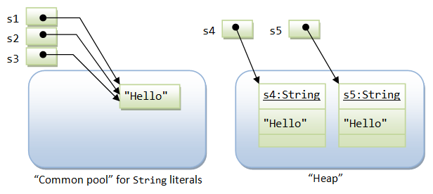
String Literal & String object
String s1 = "Hello"; // String literal
String s2 = "Hello"; // String literal
String s3 = s1; // same reference
String s4 = new String("Hello"); // String object
String s5 = new String("Hello"); // String object

Slide 13
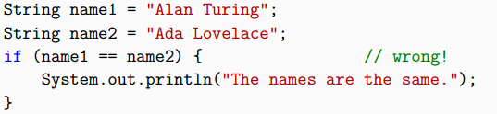
String equality(字符串相等)
Do not use the == and != operators to check whether two strings are equal
The problem is that the == operator checks whether the two variables refer to the same object.
The value of name1 and name2 are address of the objects in the main memory!

Slide 14

String equality
The right way to compare strings is with the equals method.
Notes:
Use the string.equals(Object other) function to compare strings, not the == operator.
The function checks the actual contents of the string, the == operator checks whether the references to the objects are equal.

Slide 15
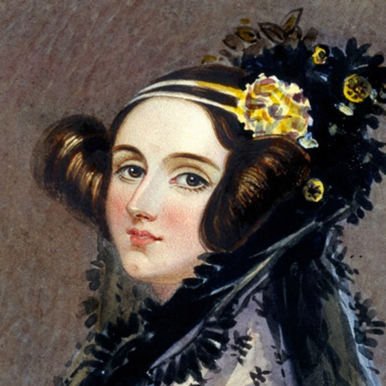
What is the output?
package edu.hit.java.string;
public class StringTest(){
public static void main(String[] args){
String str1=“Ada Lovelace”;
String str2=“Ada Lovelace”;
String str3=new String(“Ada Lovelace”);
if(str1==str2)
System.out.println(“str1==str2”);
if(str1.equals(str2))
System.out.println(“str1.equals(str2)”);
if(str1.equals(str3))
System.out.println(“str1.equals(str3)”);
}
}
Ada Lovelace, the 1st Programmer in history
Notes:
英国诗人拜伦的女儿Ada Lovelace 被认为时历史上第一个程序员

Slide 16
String comparison
The compareTo() method is used when we need to determine the order of Strings lexicographically.
String name1 = "Alan Turning";
String name2 = "Ada Lovelace";
if (name1.compareTo(name2) == 0) {
System.out.println("The strings are equal.");
}else if (name1.compareTo(name2) < 0) {
System.out.println("name2 follows name1");
} else { //true
System.out.println("name1 follows name2");
}
Notes:
按字典顺序比较两个字符串。该比较基于字符串中各个字符的 Unicode 值。
如果参数字符串等于此字符串，则返回 0 值；compareTo 只有在方法 equals(Object) 返回 true 时才返回 0
如果按字典顺序此字符串小于字符串参数，则返回一个小于 0 的值；
返回这两个字符串在位置 k 处的两个不同的 char 值 this.charAt(k)-anotherString.charAt(k)
如果它们没有不同的索引位置，则较短字符串在字典顺序上位于较长字符串的前面。
这种情况下，compareTo 返回这两个字符串长度的不同，即值：this.length()-anotherString.length()
如果按字典顺序此字符串大于字符串参数，则返回一个大于 0 的值

Slide 17
String are immutable(不可变)
String provides some methods, e.g. toUpperCase, toLowerCase, replace, substring, format, etc.
Theses methods can not change the characters of the String, they just generate a new string object as a return value.
If you don’t save the return value, invoking these methods has no effect.

Slide 18
Uppercasing & Replacing strings
String name = "Alan Turing";
String newName=name.toUpperCase();
System.out.println(name);
System.out.println(newName);
String text = "Computer Science is fun!";
String newText=text.replace("Computer Science", "CS");
System.out.println(text);
System.out.println(newText);

Slide 19
Substrings
The substring method returns a new string that copies letters from an existing string, starting at the given index.
fruit.substring(0) returns "banana"
fruit.substring(2) returns "nana"
fruit.substring(6) returns ""
fruit.substring(0, 3) returns "ban"
fruit.substring(2, 5) returns "nan"
fruit.substring(6, 6) returns ""

Slide 20
String formatting
String.format takes the same arguments as System.out.printf
String s= String.format("%02d:%02d %s", 9, 30, “AM”);
The main difference is that
System.out.printf displays the result on the screen;
String.format creates a new string, but does not display anything.
http://docs.oracle.com/javase/7/docs/api/java/util/Formatter.html#syntax

Slide 21
More about String
String Concatenation
Converting primitive types to strings
Converting strings to primitive types
Splitting strings
Command-line arguments

Slide 22
String Concatenation(字符串连接)
The '+' operator, which performs addition on primitives (such as int and float), is also used to perform concatenation for two String operands.
String name=“Trump”;
float weight=85.0f, height=1.86f;
String text = "Student:";
text = text + name + “,” + weight + " kg";
text += height + “m \n";

Slide 23
Converting primitive types to strings
Implicit conversion
String nine = “”+9;
Explicit conversion
String nine = String.valueOf(9);

Slide 24
Converting strings to primitive types
For each primitive type, there is a corresponding class in the Java library, called a wrapper class.
The wrapper class for char is called Character; for int it’s called Integer. Other wrapper classes include Boolean, Long, and Double.
Wrapper classes provide methods for converting strings to other types. For example
String mystr = "12345"; int num = Integer.parseInt(str);
String yourstr= Integer.toString(num);

Slide 25
Splitting strings(分割字符串)
Very often, you need to break a line of texts into tokens delimited by white spaces. There are two ways:
The method split()
String sentences="Monday Tuesday Wednesday Thursday Friday Saturday Sunday“
String[] tokens = sentences.split("\\s");
The class java.util.StringTokenizer
StringTokenizer itr = new StringTokenizer(sentences);

Slide 26
Command-line arguments(命令行参数)
Now that you know about arrays and strings, we can finally explain the args parameter in the main method.
public class Hello { public static void main( String[] args) { System.out.println("Hello “+args[0]); } }
if you run it like this:
java Hello Trump!
The output is:
Hello Trump!
if you run it like this:
java Hello Donald Trump!
What is the output?

Slide 27
StringBuilder & StringBuffer
As explained earlier, Strings are immutable because String literals with same content share the same storage in the string common pool.
JDK provides two classes to support mutable strings: StringBuffer and StringBuilder (in core package java.lang), which are stored in the heap and not shared.

Slide 28
StringBuilder & StringBuffer
Methods for building up the content
StringBuffer append(type arg)
StringBuffer insert(int offset, type arg)
type could be primitives, char[], String, StringBuffer, etc
Methods for manipulating the content
StringBuffer delete(int start, int end)
StringBuffer deleteCharAt(int index)
void setLength(int newSize)
void setCharAt(int index, char newChar)
StringBuffer replace(int start, int end, String s)
StringBuffer reverse()

Slide 29
StringBuilder & StringBuffer
StringBuilder class is the same as StringBuffer class, except that StringBuilder is not synchronized for multi-thread operations.
However, for single-thread program, StringBuilder, without the synchronization overhead, is more efficient.

Slide 30
StringBuilder & StringBuffer
Strings are more efficient if they are not modified (because they are shared in the string common pool).
However, if you have to modify the content of a string frequently (such as a status message), you should use the StringBuffer class (or the StringBuilder) instead.
String msg = "a" + "b" + "c";
String msg = new StringBuffer().append("a").append("b").append("c").toString();

Slide 31
Example: Reverse words
String str = "Monday Tuesday Wednesday Thursday Friday Saturday Sunday";
String strReverse;
StringBuilder sb = new StringBuilder();
String[] tokens = str.split("\\s"); // white space '\s' as delimiter
for (int i = 0; i < tokens.length; ++i) {
sb.insert(0, tokens[i]);
if (i < tokens.length - 1) {
sb.insert(0, " ");
}
}
strReverse = sb.toString();
System.out.println(strReverse);

Slide 32
Example: Generating random string
public static String genRandomString(int length){
String str= "ABCDEFGHIJKLMNOPQRSTUVWXYZ";
Random random=new Random();
StringBuffer sb=new StringBuffer();
for(int i=0;i<length;i++){
int number=random.nextInt(26);
sb.append(str.charAt(number));
}
return sb.toString();
}

Slide 33
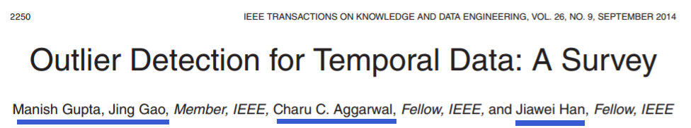
Quiz: APA author name conversion
APA citation format
Gupta, M., Gao, J., Aggarwal, C. C., & Han, J. (2014). Outlier detection for temporal data: a survey. IEEE Transactions on Knowledge & Data Engineering, 26(9), 2250-2267.
APA Author’s name
Author’s Last name, First Initial.
Notes:
(American Psychological Association)

Slide 34
Quiz: APA author name conversion
Conversion cases
Case 1:
Manish Gupta → Gupta, M.
Jing Gao → Gao, J.
Case 2:
George Walker Bush → Bush, G. W.
Donald John Trump → Trump, D. J.
Dewayne E. Perry → Perry, D. E.

Slide 35
The BMI application
How to avoid inputting duplicate data?

Slide 36
Avoid inputting duplicate data?
In BMI application, how to void inputting duplicate data?
Use String array to store the student IDs
Input a student ID
check whether the student ID is already in the array
If true, prompt user that the information of the student has been in the system
Else, store the student ID in the array and prompt user to input name, weight and height of the student

Slide 37


